Slide 1
Human & Organizational Performance: A Mindset That Can Universally Drive Operational Excellence
Pete Susca & Matt Twerdy
January 2023

Slide 2
agenda
This Webinar will help understand how to develop more resilient organizations. Expanding your view of Safety.
Pete and Matt will discuss how systems and processes foster organizational excellence, and how you can begin to transform your own organization.
You can’t manage what you don’t understand, and HOP principles help you peel back the layers to begin the work of understanding.
You cannot change the human condition, but you can change the conditions in which humans work.

Slide 3
Organizational Health?
Robust Values and the Ability to Keep Them Healthy and in Balance

Slide 4
Most organizations have sound values, the challenge is typically how they make decisions across them.
VALUES / IMPERATIVES
Limits
Balanced Business Decisions
The Frontline

Slide 5
Organizational & Operational Factors
(Culture)
Management Systems
Processes
Benefit
Risk
Results

Slide 6
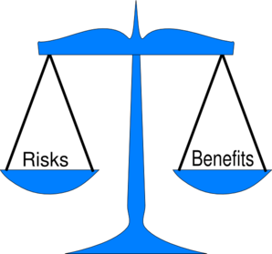
The Critical Path
I. The organization does not have a way to make value-balanced decisions

Slide 7
The Critical Path
II. Management systems are not robust enough to predict/prevent imbalance

Slide 8
The Critical Path
III. Decisions create processes
with imbalanced benefit vs. risk
These processes foster:
Excessive risk and waste
Unnecessary frontline decisions

Slide 9
Organizational & Operational Factors
(Culture)
Management Systems
Processes
Benefit
Risk
Results

Slide 10
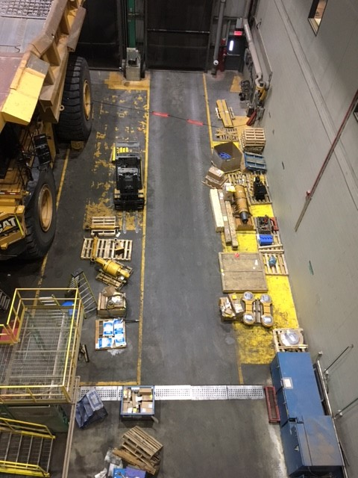
9

Slide 11
Organizational Health In Summary
The “health” of an organization is dictated by its values and it’s ability to maintain balance between them.
When values/imperatives are balanced in business decision-making - tremendous benefit will be gained.

Slide 12
Human and organizational performance (HOP) Principles
Matthew J. Twerdy, SGE, CSP, CHMM
Dir, EH&S, Collins Aerospace

Slide 13
Defining safety
Safety is not the absence of accidents, but the presence of capacity. – Tod Conklin
Traditional Safety
Workers are the problem to be fixed. We improve safety by making the workers better.
We must tell workers what to do and, perhaps more important, what not to do.
Safety is the absence of accidents
Expanding our view of Safety
Workers are not the problem, they are the problem solvers
We don’t tell our organizations what to do, we should ask them what they need
Safety is not the absence of accidents, it is the presence of capacity
Shifting/Adapting Our Mindset

Slide 14
Work As Imagined (Prescribed) vs. Work As Done
If we don’t learn about the conditions in which work is happening, we don’t change them, and we spend time fixing the wrong things. We need to be learning when things go wrong – but even more importantly, we need to learn from normal work and everyday processes.
All systems are running from order to disarray through entropy – all systems move toward degradation, so we need to continually check and monitor our systems to learn and improve.
Notes:
The terms ‘work-as-imagined’ and ‘work-as-done’ help to convey that the way that people think about work and the way that work is actually done are not necessarily the same. (Ref: Erik Hollnagel)
Key Points (Ref: Erik Hollnagel)
1. Work-as-imagined (WAI) refers to the various assumptions, explicit or implicit, that people have about how their or others’ work should be done.
2. Work-as-done (WAD) refers to how something is actually done, either in a specific case or routinely.
3. There is a difference between how work is ‘imagined’ or thought of and how work is actually done. This may or may not be problematic.
4. The solution to the gap is to try to understand what determines how work is done and to find effective ways of managing that to keep the variability of WAD within acceptable limits.

Slide 15
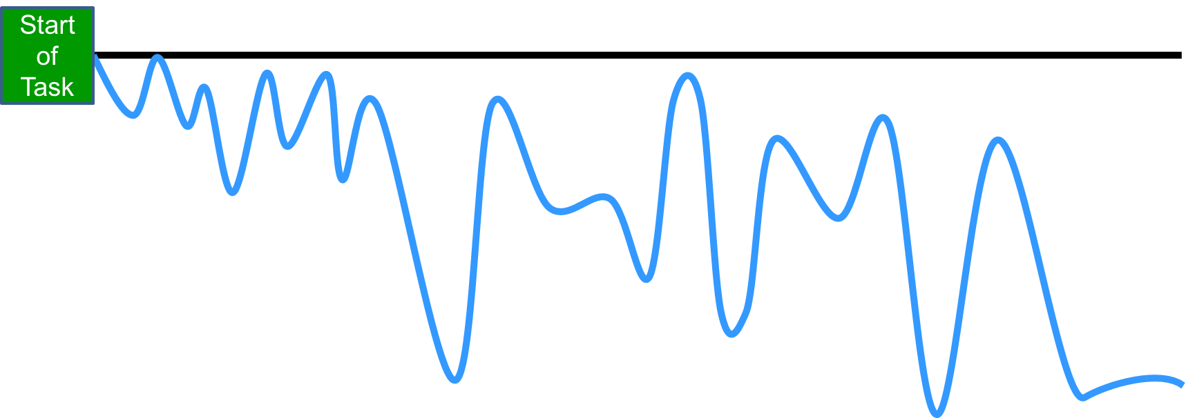
Work as IMAGINED vs work as DONE
How work tasks are really completed
BLACK LINE – Work-as-planned (Policy/Procedure/Standard Work)
BLUE LINE – Work-as-done (Reality of how it is performed)
Employees are the “masters of the BLUE LINE”, the heroes of our workplace
Traditional Safety Management Focus
Didn’t Follow the requirements or process
Why does this happen?
Overcoming Obstacles
Adaptions
Adjustments
Work-Arounds
Problem Solving
Tweaking
Fine tuning
Goal trade-offs
Normally Successful!
Human Operational Performance Focus
Learning…
Why was deviation needed?
What problems or obstacles existed?
How can we fix the system to support better decisions?
EVENT
Blame fixes nothing!
Defense Capacity
Operational Risk Accumulation
Notes:
How work REALLY gets done…
In this diagram, the BLACK line represents the work as it was planned and documented in procedures, work instructions, policies, etc.
The BLUE line represents that work tasks are somewhat variable. Work does not always follow the BLACK line path
Basically, that work is variable based upon external factors. Our employees are the “masters of the BLUE line”, the heroes of our workplace. They find a way to get the work done
There are many reasons this type of action is needed by the employees
There may be obstacles to overcome
The need to solve problems that arise during the task
Adapting to unforeseen issues
Working around problems to get the desired result.
In the vast majority of situations, the employees are successful in completing the task without a negative impact
This does, however, mean that there is a certain amount of unplanned activity that can lead to an accumulation of risk in the task

Slide 16
Work as Done vs work as imagined
Example: Driving a Car
Work as imagined (black line)
Follow speed limit
Both hands on the wheel
Keep distance between cars
Use turn signals
Obey all traffic signs
Pay attention
Work as done (blue line)
Bad weather
Other (bad) drivers
Forget turn signals
Distractions
Speeding/Rushing
Road rage
Controls (capacity)
AWD
Horns
Blind Spot Indicators
Lane Assist
Automatic Braking
Seats belts
Airbags
Phone driving settings
Change the conditions in which humans work.

Slide 17
Human and organizational performance
Human and Organizational Performance is essentially about understanding the context and conditions of work. Importantly, HOP is not a program – it’s an operating philosophy that gives us a framework for building more resilient organizations.
There are five principles within HOP that shape and influence the way organizations think, act, view success and respond to failure.
These principles work together to change the way we think about work and how to improve it.

Slide 18
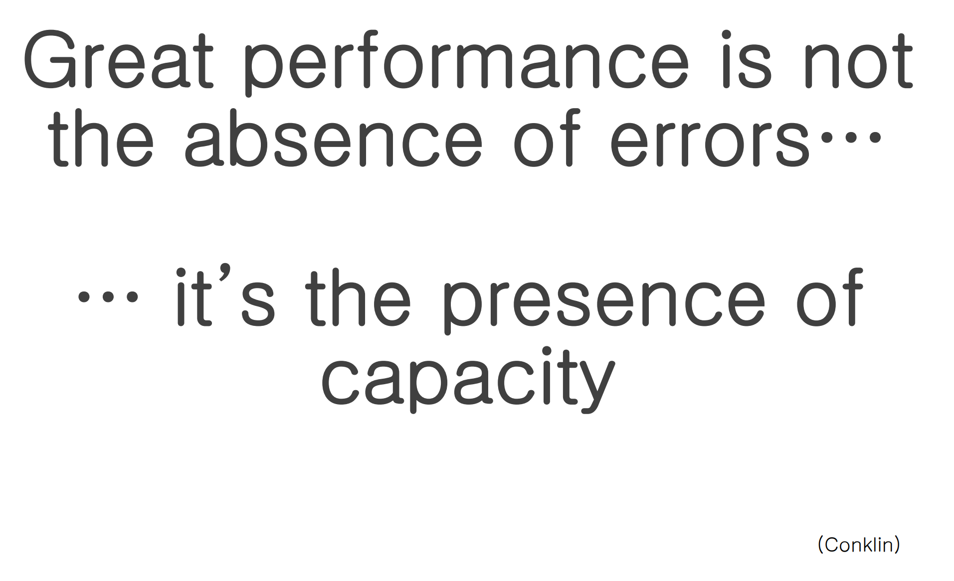
People Make mistakes
HOP Principle #1
Everyone makes mistakes
We should design our systems to anticipate mistakes
We need to ask, “What happens when someone makes an error or mistake?” And seeks to design safeguards for such situations.
When mistakes do occur, the systems should fail safely
Example: blind spot indicators
The goal of Human and Organizational Performance is to become a lot less surprised by human error and instead become a lot more interested in learning from mistakes to build more tolerant forgiving systems that fail safely. Human and Organizational Performance looks to tap into the workers as the solution by engaging them following an injury, near miss, good catch, high risk operation and even successes!
Notes:
Key speaker points:
“Human and Organizational Performance is based on the premise that humans are error prone and that if we expect people to do things right all the time, we are most likely going to be disappointed – a lot!” –Andrea Baker
The goal of Human and Organizational Performance is to become a lot less surprised by human error and instead become a lot more interested in learning from mistakes to build more tolerant forgiving systems that fail safely. Human and Organizational Performance looks to tap into the workers as the solution by engaging them following an injury, near miss, good catch, high risk operation and even successes!

Slide 19
Blame fixes nothing
HOP Principle #2
“Blame is emotionally satisfying, just not very operationally satisfying”
It is easy to label people unfairly…blame makes us feel like we have done something wrong
If you blamed somebody, what did you fix to make the process better?
The next person to come along could make the same exact mistakes, because we haven’t fixed the system
HOP recognizes that those involved in accidents and incidents have an important role to play in the process of restoring and learning
By taking blame away, we enable better learning.

Slide 20
Blame is incompatible with safety

Slide 21
Context drives behavior
HOP Principle #3
Workers don’t make bad choices, they are given bad options
People do what they do because it made sense at the time, with the information they had
Do not say could’ve, should’ve, would’ve
Instead, ‘get in the tunnel’ with the employee and learn to understand the situation from their perspective
Then ask; how do we change the system so that people are not forced to make these tough decisions

Slide 22
Local rationality
Notes:
Dekker

Slide 23
Learning and improving is vital
HOP Principle #4
We want to learn the weak points in our system so that we can building in extra capacity

Slide 24
Learning and improving is vital

Slide 25
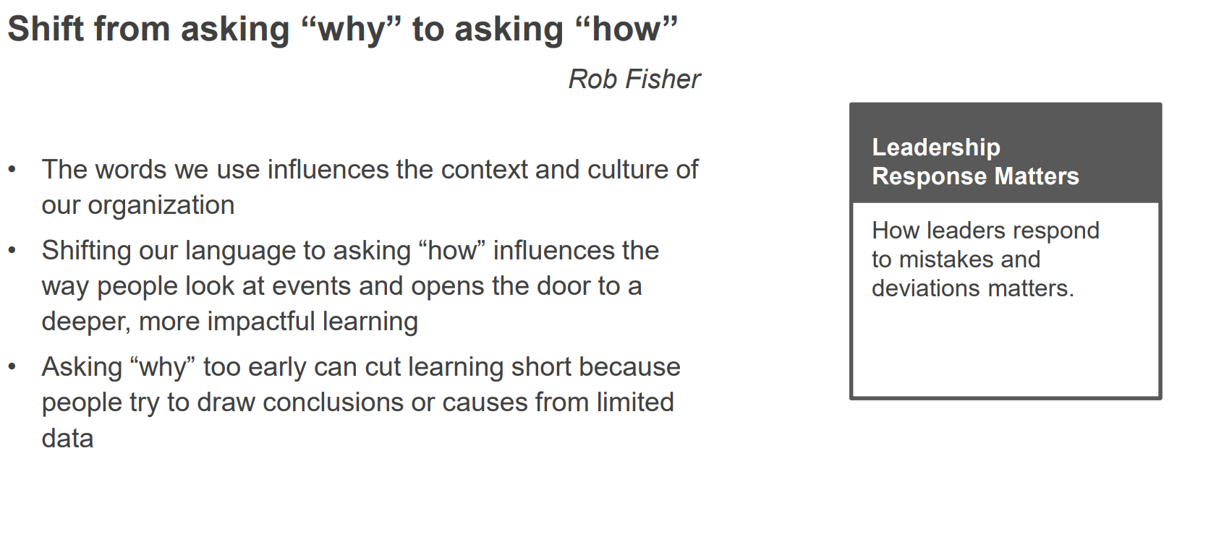
Leader’s response matters
HOP Principle #5
Nine Things Managers Should Ask First and in Order When They are Notified that Something Unexpected Happened
Your response to an event matters!
Are the people OK?
Is the facility safe, secure, and stable?
Tell me the story of what happened.
What could have happened?
What factors led up to this event?
What worked well? What did not work well?
Where else could this happen?
What else do I need to know about this event?
Leaders or Managers should know this little but important fact. The way they react or respond to an operational failure matters – and it matters a lot. Coach, counsel, and press your leaders into knowing that they play an enormous role in event learning, and organizational culture.
These nine things remind managers to be aware of both their reactions and responses; it suggests some better alternatives to ask when confronted with an event.
Notes:
Key speaker points:
Leaders or Managers should know this little but important fact. The way they react or respond to an operational failure matters – and it matters a lot. Coach, counsel, and press your leaders into knowing that they play an enormous role in event learning, and organizational culture.
These nine things remind managers to be aware of both their reactions and responses; it suggests some better alternatives to ask when confronted with an event.
When we actively try to gather explanations and stories, and not reasons and causes, we will get decidedly different, higher quality reporting of events, unsafe conditions, or near misses.
Reference: Todd Conklin (Pre-Accident Investigations: An Introduction to Organizational Safety)

Slide 26
Human and organizational performance
Summary
Error is normal, people make mistakes
Learning is vital - Improvement happens through learning to help us improve our systems
Blame fixes nothing
Work isn’t always accomplished the way we think – BLUE LINE IS ALWAYS ADAPTING
LEARN how the “context of work” may have influenced the “employee mindset”
Human error and employee decisions may be a symptom of trouble deeper inside our system
Be less surprised by human error and failure...and become a lot more interested in learning…..
Notes:
In summary, we can remember…
That error is normal, people will make mistakes
Learning from an incident is vital
Blame fixes nothing
Work is variable and doesn’t always happen as planned
The expanded event factors chart can help us integrate safety culture into our incident investigations
The goal is to use the expanded event factors chart to LEARN how the context of work may have influenced the employee mindset and the decisions made
This is why it is important to interview the people involved with an open-minded approach, expecting to learn from them and understand WHY they made the decisions they made
This tool can help us identify where are processes and systems can be improved to remove obstacles and support our employees in making better decisions and avoid incident recurrence

Slide 27
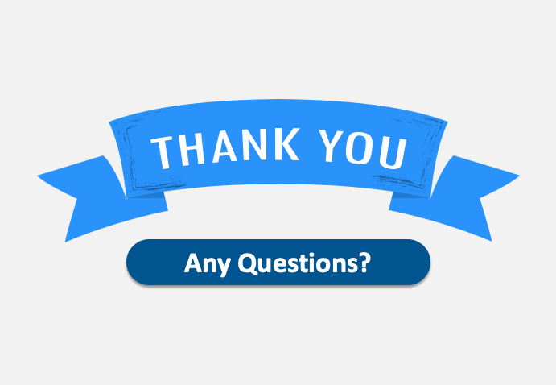
Human & Organizational Performance: A Mindset That Can Universally Drive Operational Excellence
Peter Susca, Principal Operational Excellence LLC (OpX Safety) opxsafety@cox.net Opxsafety.com 860-713-8050
Matthew J. Twerdy, SGE, CSP, CHMM
Collins Aerospace
Matthew.Twerdy@Collins.com
860-654-6061

