Slide 1
Annual Meeting of the Membership at Killington Resort
June 21, 2022

Slide 2
Agenda
Introductions
Chair’s Report
Secretary’s Report
Treasurer’s Report
Committee Reports
Nominating
Communications
Labor
Membership
Mentoring
Awards
By-Laws
Labor
Vermont State Plan
OSHA Region 1 Update

Slide 3
Chair’s Report
Updates
Upcoming Chapter Meetings

Slide 4
Secretary’s Report
Secretary:
OPEN POSITION
KAREN GIRARDIN, Chapter Chair, L.L.Bean, Inc
The last Region 1 Chapter Meeting was held virtually on September 29, 2021
Chapter Meeting Minutes –

Slide 5
Treasurer’s Report as of 6/17/2022 Unaudited Information
Treasurer:
Paul Ludington, Millstone Nuclear Power Station Waterford, CT
Assets (as of 6/17/2022) = $xxx,xxx.xx
Checking = $xxx,xxx.xx
Certificate of Deposit = $xx,xxx.xx
Expenses for future conferences continue to be incurred throughout the year.
Expenses are off-set by donations!! Please consider donating time, money, gifts in kind, facilities, no matter how big. ALL DONATIONS MAKE A DIFFERENCE.
HUGE THANK YOU TO ALL WHO DONATE!!

Slide 6
Nominating Committee Update
Committee Chair:
Jeff Stolz, Raytheon Missiles and Defense, Andover, MA
Annual elections to be held Wednesday, June 22, 2022 at the Region 1 Conference in Killington, VT.
BOD Positions up for elections (currently held by):
Vice-Chairperson (Melissia Renouf – Cintas, Fairfield, CT)
Secretary - Open
Union Rep (Bruce Gove – Collins Aerospace, Windsor Locks, CT
Local 743 District 26 – IAMAW)
Director-at-Large (4)
Jaime Harper, Raytheon Missiles & Defense, Andover MA
Matt Twerdy, Collins Aerospace - Windsor Locks, CT
Open
Open
Vice-Chairperson, Union Rep and two Directors-at-Large are seeking reelection.
The Secretary and 2 Director-at-Large positions are open.

Slide 7
Communications Committee
Committee Chair:
Melissa Renouf, Regional Safety & Health Manager, Cintas
Renoufm@Cintas.com
E-mail For Region 1 VPPPA
reg1vpppa@gmail.com
Goals:
Share & Inform:
Regional happenings
Mentoring
Board elections
Conferences
Scholarships

Slide 8
How do we connect and share?
E-mail
Constant Contact
Webpage
www.vppregion1.com
Social Media
LinkedIn, Facebook, Instagram, Twitter

Slide 9
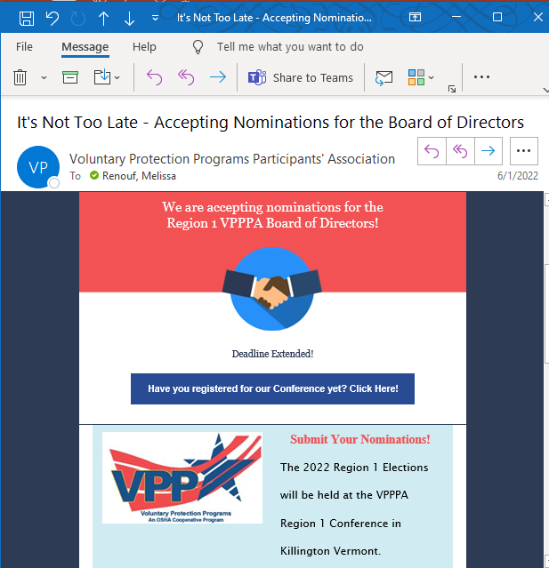
E-mail Lists
In process of updating e-mail lists
Are you receiving the e-mails?
Do we have the correct contact from your organization?

Slide 10
Website

Slide 11
Feedback? Questions?
Reach out to Melissa Renouf
Renoufm@cintas.com

Slide 12
Membership Committee Update
Committee Chair:
Jaime Harper, Raytheon Missiles & Defense
Membership Goal = 100% of Region 1 VPP Sites
Member Benefits:
Symposium/Conference Discounts
Leader Magazine
Special Regional Events
Best Practice Sharing

Slide 13
Membership Committee Update

Slide 14
Mentoring Committee Update
Committee Chair:
Matt Twerdy, Collins Aerospace - Windsor Locks, Connecticut
​VPPPA members share their success to make workplaces safer across the globe
Mentoring program pairs sites with sites that are just starting their VPP journey, need additional program guidance, or are looking to improve best practices at their facilities.

Slide 15
Mentoring Program
Mentors have been through the VPP audit process several times and are committed to helping other VPPPA members achieve excellence.
Mentors often understand challenges that are unique to a site’s specific situation.
This is a unique opportunity to get hands-on guidance from a seasoned professional who has been in the exact same position.

Slide 16
Current Mentor Status
Mentor | Mentee | Status
Collins Aerospace | Berkshire Power Company, LLC-Agawam, MA | Active
Cianbro | MAS Building and Bridge, Inc., Norfolk, MA | Active
OSHA/Collins Aerospace | Methuen Construction – Plaistow, NH | Active - Application submitted

Slide 17
Region I Mentoring Contacts
Matthew J. Twerdy, SGE, CSP, CHMM – Director EH&S
Collins Aerospace – Windsor Locks, CT
e-mail: matthew.twerdy@collins.com
Brian Sullivan – Region I VPP Coordinator
US Dept. of Labor – OSHA
e-mail: Sullivan.Brian@dol.gov
Complete the National VPPPA “Volunteer as a Mentor ” or “Request a Mentor” form

Slide 18
Awards Committee Update
Committee Chair:
Paul Ludington, Millstone Nuclear Power Station Waterford, CT
3 Scholarships Available: All are worth $1,000.00
Eric Bartsch Memorial Safety & Health Scholarship
Caswell Plante Academic Excellence Scholarship
Joseph Gervais Memorial Community Service Scholarship
Info and applications will be up on website: www.vppregion1.com when the announcements go out on social media.
Application due dates and dates winners will be announced will be on the applications, website, and on social media.

Slide 19
By-Laws Committee Update
Committee Chair:
Karen Girardin, Chapter Chair, L.L.Bean, Inc
No changes at this time

Slide 20
Labor & Management Committee Update
Committee Chair:
Bruce Gove, Collins Aerospace Systems RTX, Windsor Locks, CT
Local 743 District 26 – IAMAW
Labor Summit online webcast
June 9, 2022, one year anniversary “One Hour Special”, Topic: STOP WORK-presenters Jack Griffith- National VPPPA -Labor Representative, Benjamin Heurung, West Coast Representative, Metal Trades/AFL-CIO
National LM committee will be scheduling monthly Labor Summits
Safety+ Symposium workshop “Unique role of a Union Safety Rep”

Slide 21
Vermont OSHA Update – State Plan
Committee Chair:
Dan Whipple, VOSHA Program Manager
Email: dan.whipple@vermont.gov
Phone (802) 828-5084
Karl Hayden, VPP Program Manager
Email: karl.hayden@vermont.gov
Phone (802) 279-2240
Continuing to support the Green Mountain VPP
Strong Safety & Health Programs = Sound Business

Slide 22
Active Green Mountain VPP Sites:
Vermont Electric Coop
Atlas Technical Consultants – Vermont
Unilever North America Ice Cream (Ben and Jerry’s – St. Albans)
Global Foundries

Slide 23
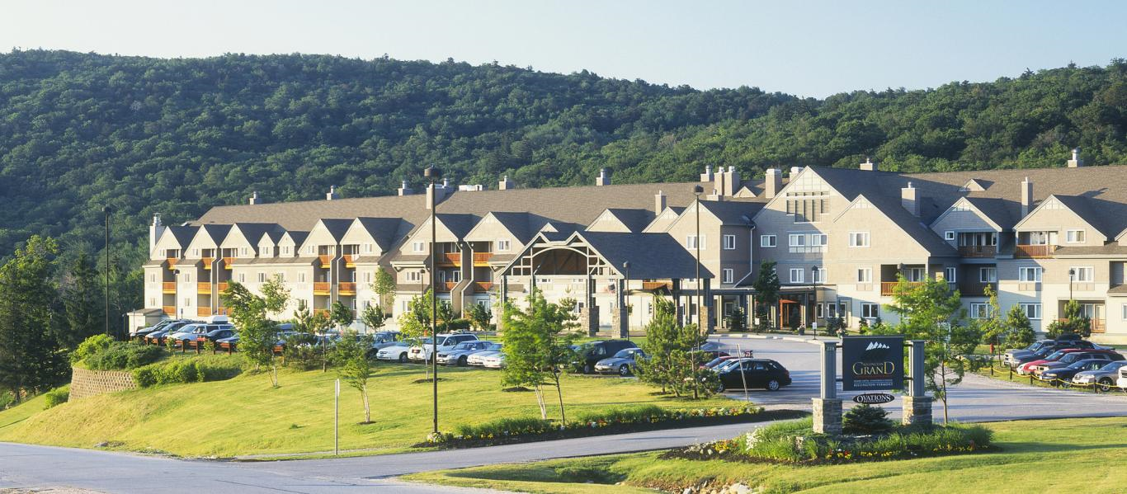
Other Business
Any Old Business?
New Business:
Safety+ Symposium VPPPA Tuesday, Aug. 23 – Thurs. Aug. 25, 2022, in Washington, DC at the Walter E. Washington Convention Center.
Negotiations being had with venues to plan for the Region 1 2023 Safety & Health Excellence Conference & Expo. Keep watch on the Region 1 website for more information.

Slide 24
Region I Conference Locations
2005 – CT, Mystic Marriott
2006 – VT, Burlington Sheraton
2007 – CT, Mystic Marriott
2008 – RI, Newport Marriott
2009 – VT, Killington
2010 – ME, Sugarloaf
2011 – MA, Ocean Edge, Cape Cod
2012 – VT, Killington
2013 – MA, Ocean Edge, Cape Cod
2014 – ME, Inn by the Bay, Portland
2015 – MA, Sea Crest, N. Falmouth
2016 – NH, Radisson, Manchester
2017 – VT, Killington
2018 – MA, Sea Crest, N. Falmouth
2019 – ME, Inn by the Bay, Portland
2020 – VT, Killington - CANCELLED
2021 – VT, Killington - CANCELLED
2022 – VT, Killington
2023 – CT, ???? TBD
Times in each state:
ME = 3 NH = 1 VT = 5
MA = 4 CT = 2 RI = 1

Slide 25
Region I, VPPPA “The Best in the Northeast!” THANKS TO YOU!!!

