Slide 1
Chapter Meeting Cintas – Chelmsford, MA
February 25, 2020

Slide 2
Agenda
Introductions
Chair’s Report
Secretary’s Report
Treasurer’s Report
Committee Reports
Nominating
Communications
Labor
Membership
Mentoring
Awards
By-Laws
Vermont State Plan
OSHA Region 1 Update

Slide 3
Chair’s Report
Outreach:
Reps from VPP participants Raytheon & Thermo Fisher Scientific will be part of a STEM expo for 4th, 5th, 6th graders for the Mansfield, MA school system on 4/4/20
Providence, RI OSHA Office Area Director & Compliance Assistant are planning to host a meeting with local VPP participants & a couple local companies about shift-change reports (conveying info between work shifts, etc). Looking for construction industry & hospitals to assist in the effort.
Upcoming Chapter Meetings:
June 15, 2020 at Region 1 Safety & Health Excellence Conference
August 25, 2020 at the National Safety+ Symposium
Fall – TBD Looking for a host site.

Slide 4
Secretary’s Report
Secretary:
Deb Bowie, Coca-Cola Northampton, MA
During the last week of August 2019 Region 1 held a networking meeting during the Safety+ Symposium.
The last Region 1 Chapter Meeting was held at the Annual Region 1 Conference at the Holiday Inn by the Bay, Portland, ME on May 21, 2019.
Chapter Meeting Minutes – Review & Approval

Slide 5
Treasurer’s Report as of 1/31/2020 Unaudited Information
Treasurer:
Paul Ludington, Millstone Nuclear Power Station Waterford, CT
Assets (as of 1/31/2020) = $XXX,XXX.XX
Checking = $XXX,XXX.XX
Certificate of Deposit = $XX,XXX.XX
Expenses for the 2020 conference are already being incurred and being paid.
Expenses are off-set by donations!! Please consider donating time, money, gifts in kind, facilities, etc.
HUGE THANK YOU TO ALL WHO DONATE!!

Slide 6
Awards Committee Update
Committee Chair:
Paul Ludington, Millstone Nuclear Power Station Waterford, CT
3 Scholarships Available: All are worth $1,000.00
Eric Bartsch Memorial Safety & Health Scholarship
Caswell Plante Academic Excellence Scholarship
Joseph Gervais Memorial Community Service Scholarship
Info and applications on website: www.vppregion1.com
Scholarship Application Due Date: February 28, 2020
Winner(s) Announced: March 27, 2020

Slide 7
Nominating Committee Update
Committee Chair:
Mike Avery, Cartamundi East Longmeadow, MA
Annual elections to be held Tuesday, June 16, 2020. (7 AM – 11 AM at the conference registration area.)
BOD Positions up for elections (currently held by):
Vice Chairperson (Mike Avery – Cartamundi)
Secretary (Deb Bowie – Coca-Cola)
Hourly Rep from site with Collective Bargaining Unit/Union (Bruce Gove – Collins)
Director-at-Large (3) (Cindy Raspiller – Raytheon; Glen Garfield – Collins; OPEN Position)
All are seeking re-election except for 2 Director-at-Large positions.

Slide 8
Communications Committee Update
Committee Chair:
Melissa Renouf, Regional Safety & Health Manager, Cintas
Renoufm@Cintas.com
E-mail For Region 1 VPPPA
reg1vpppa@gmail.com
Goals:
Share regional happenings, mentoring, board elections, conference information, etc. with our contacts via multiple mediums.

Slide 9
How do we connect and share?
E-mail
Constant Contact
Webpage
www.vppregion1.com
Social Media
LinkedIn
Facebook

Slide 10
Feedback & Notes
Please submit articles and photos for the next VPPPA Leader publication, as well as our website.
If you are not receiving our communications, please let us know.
We continue to seek ways to use Constant Contact and other communications more effectively.
Share
Join
Help

Slide 11
Labor & Management Committee Update
Committee Chair:
Bruce Gove, Collins Aerospace System UTC, Windsor Locks, CT
Local 743 District 26 – IAMAW
Labor & Management open forum at the Safety+ Symposium on Tuesday August 25th.
Safety+ Symposium workshop “Unique role of a Union Safety Rep”
Federal mediation training class being offered

Slide 12
Membership Committee Update
Committee Chair:
Carl Allen, Huber Engineered Woods, LLC, Easton, ME
Membership Goal = 100% of Region 1 VPP Sites
Member Benefits:
Symposium/Conference Discounts
Leader Magazine
Special Regional Events
Best Practice Sharing

Slide 14
Mentoring Committee Update
Committee Chair:
Cindy Raspiller, Raytheon - Andover, MA
What is Mentoring?
Men·​tor | \ ˈmen-ˌtȯr, -tər \
Noun
A: a trusted counselor or guide
//a mentor who, because he is detached and disinterested, can hold up a mirror to us
B: tutor, coach
//The student sought a mentor in chemistry
Verb
: to serve as a mentor for : tutor

Slide 15
Mentoring Committee Update
Mentor of the Year Nominations
Have a great mentor or know a great mentor?
Accepting Nominations through March 6th
Email to cindy.raspiller@raytheon.com
Include Name, Company, email address and a brief description of why they are amazing!
National Mentoring Committee Update
Mentoring Committee working to become more active
Soliciting input from the Regions on needed resources
Developing Collateral
Mentoring Flyer
Mentor Workshop Package – led by Region I
Any volunteer reviewers?

Slide 16
Draft Mentoring Workshop Agenda
What is Mentoring?
What do VPP Mentors do?
What do VPP Mentees?
Other Mentoring Benefits
How do I get started as a Mentor / Mentee?
VPP Mentoring Roadmap
Mentoring Tips, Tricks & Tools
Resources

Slide 17
Current Mentor Status
Mentor | Mentee | Status
 | Harris Rebar – Pawtucket, RI | Requested
Acushnet | Chatham Village Foods – Wareham, MA | Active
Dighton Power | Kleen Energy – Middletown, CT | Active
Dominion Energy | Honeywell – Northford, CT | Active
Huber Engineered Woods | Irving Forest Products – ME | Active
Raytheon | New England Sheets – Devens, MA | Active
Cartamundi | Cintas – Windsor, CT | Complete
Cartamundi | Mayberry Material Handling – East Longmeadow, MA | Inactive
Coca-Cola | Harris Rebar – Deerfield, MA | Inactive
FLEXcon | High Liner Foods – Peabody, MA | Inactive
FLEXcon | High Liner Foods – Portsmouth, NH | Inactive
Cartamundi | Cintas – Branford, CT | Unknown
Pratt and Whitney | Sysco Corporation – Westbrook, ME | Unknown

Slide 18
Region I Mentoring Contacts
Cindy Raspiller – Director EHSS
Raytheon Company – Andover, MA
e-mail: cindy.raspiller@raytheon.com
Brian Sullivan – Region I VPP Coordinator
US Dept. of Labor – OSHA
e-mail: Sullivan.Brian@dol.gov
Complete the National VPPPA “Become a Mentor ” or “Request a Mentor” form

Slide 19
By-Laws Committee Update
Committee Chair:
Glen Garfield, Collins Aerospace System UTC, Windsor Locks, CT
Local 743 District 26 – IAMAW
No changes

Slide 20
Vermont OSHA Update – State Plan
Committee Chair:
Dan Whipple, VOSHA Program Manager
Email: dan.whipple@varmont.gov
Phone (802) 828-5084
Karl Hayden, VPP Program Manager
Email: karl.hayden@vermont.gov
Phone (802) 828-2033
Continuing to support the Green Mountain VPP
Strong Safety & Health Programs = Sound Business

Slide 21
Active Green Mountain VPP Sites:
Energizer Battery – Bennington
Ben and Jerry’s – Saint Albans
Curtis Lumber – Burlington
GE – Rutland
Global Foundries – Essex Junction
Vermont Electric Coop (VEC)
ATC Group Services, LLC

Slide 22
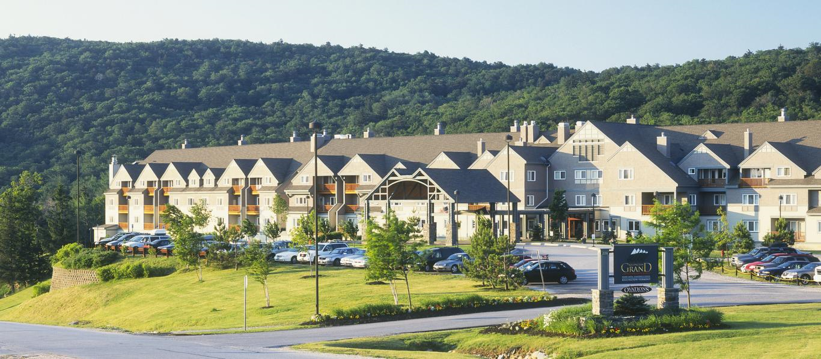
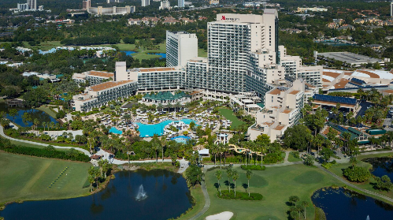
Other Business
Any Old Business?
New Business:
Region 1 2020 Safety & Health Excellence Conference & Expo Killington Resort in Killington, VT June 15th – 17th. Registration is open NOW!
2020 National Safety+ Symposium at Orlando World Center Marriott in Orlando, FL August 25th – 27th. Registration opens February 25. TODAY!!!

Slide 23
Region I Conference Locations
2005 – CT, Mystic Marriott
2006 – VT, Burlington Sheraton
2007 – CT, Mystic Marriott
2008 – RI, Newport Marriott
2009 – VT, Killington
2010 – ME, Sugarloaf
2011 – MA, Ocean Edge, Cape Cod
2012 – VT, Killington
2013 – MA, Ocean Edge, Cape Cod
2014 – ME, Inn by the Bay, Portland
2015 – MA, Sea Crest, N. Falmouth
2016 – NH, Radisson, Manchester
2017 – VT, Killington
2018 – MA, Sea Crest, N. Falmouth
2019 – ME, Inn by the Bay, Portland
2020 – VT, Killington
2021 – TBD
2022 – TBD
Over 16 years # of times in each state:
ME = 3 NH = 1 VT = 5
MA = 4 CT = 2 RI = 1

Slide 24
Region I, VPPPA “The Best in the Northeast!” THANKS TO YOU!!!

