Slide 1
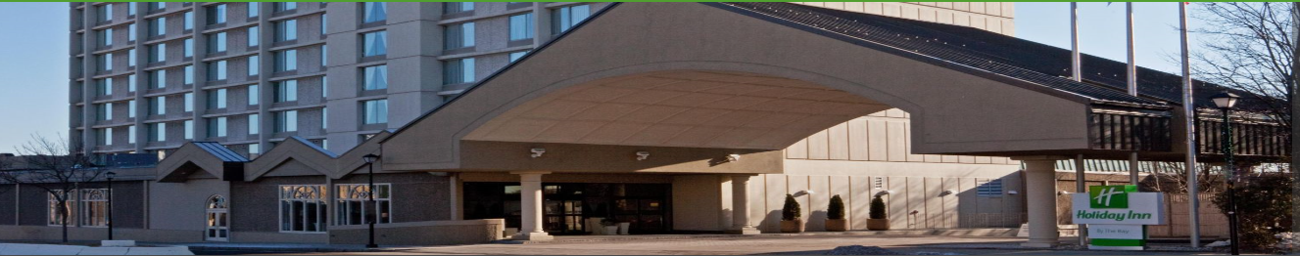

Region I, VPPPA
“The Best in the Northeast!”
ANNUAL MEETING
MAY 20, 2019
WELCOME
Holiday Inn by the Bay Portland, ME.

Slide 2
Agenda
Introductions
Chair’s Report
Secretary’s Report
Treasurer’s Report
Chapter Committee Reports:
  Nominating
  Communications
  Labor
  Membership
  Mentoring
  Awards
  By-Laws
  Vermont State Plan
OSHA Region 1 Update

Slide 3
Introductions
VPPPA National BOD
VPPPA Region 1 Chapter BOD Members
OSHA Region 1 Officials
Vermont Governors office
  Welcome to all attendees, especially first-timers!

Slide 4
Chair’s Report
Outreach:
  National Safety Council of Northern New England Annual Maine Safety & Health Conference in fall
  Jack Popp, Region 1 BOD, provided VPP overview & VPPPA intro to OSHA Training Institute (OTI) class in Dec.
  VPP Star worksite, Schick (Edgewell) in Milford, CT. hosted VPP meet & greet in Jan. to share best practices, network, & plant tour
  VPP Star worksite, Hypertherm, Inc. in Lebanon, NH hosted 4-hour training session & plant tour for OSHA reps on robotics in Jan.
Upcoming Chapter Meetings:
    August 28, 2019 – Annual Safety + National Symposium at Ernest N. Morial Convention Center, New Orleans, LA
    Fall – TBD Any facility interested in hosting please contact a Board Member

Slide 5
Secretary’s Report
Secretary:
  Deb Bowie, Coca-Cola Northampton
March 26, 2019, Region 1 Chapter held its quarterly meeting at Raytheon in Portsmouth, Rhode Island
Chapter Meeting Minutes – Review & Approval.
Thank you Deb!

Slide 6
Treasurer’s Report as of 4/30/2019
Unaudited Information
Treasurer:
  Paul Ludington, Millstone Nuclear Power Station
Assets (as of 4/30/2019) = $xxx,xxx.xx
  Checking = $xxx,xxx.xx
  Certificate of Deposit = $xx,xxx.xx
Expenses for 2019 conference are being incurred
Expenses are off-set by donations!!
THANK YOU TO ALL DONORS!!

Slide 7

Nominating Committee Update
Committee Chair:
  Mike Avery, Cartamundi East Longmeadow
Annual Elections to be held Tuesday, May 21, 2019. (7-11a.m. Conference registration area)
BOD Position (currently held by):
  Chairperson (Karen Girardin – LLBean)
  Treasurer (Paul Ludington – Dominion)
  Director-At-Large (3) (OPEN, Darwin Irish – Flexcon, Jack Popp - Cartamundi)
  All are seeking re-election except for Jack Popp

Slide 8
Communications Committee
Committee Chair: Karen Girardin
  kgirardin@llbean.com or reg1vpppa@gmail.com
Chapter web site www.vppregion1.com
Please Submit articles and photos for the next VPPPA Leader publication
If you are not receiving our communications please let us know.
We continue to seek ways to use Constant Contact more effectively. Thank you for your patience as we learn how.

Slide 9
Labor Committee
Committee Chair:
Bruce Gove, Collins Aerospace Systems-UTC
Local 743 District 26– IAMAW
  Labor Management
  No update at this time

Slide 10
Membership Committee
Committee Chair: Cindy Raspiller
              Raytheon, Andover, MA
  Membership Goal - 100% of New England VPP Sites
Member Benefits:
  Regional and National Conference Discounts
  Leader Magazine
  Special Chapter Events
  Best Practice Sharing
Welcome New Members:
  Honeywell – Action, MA

Slide 11
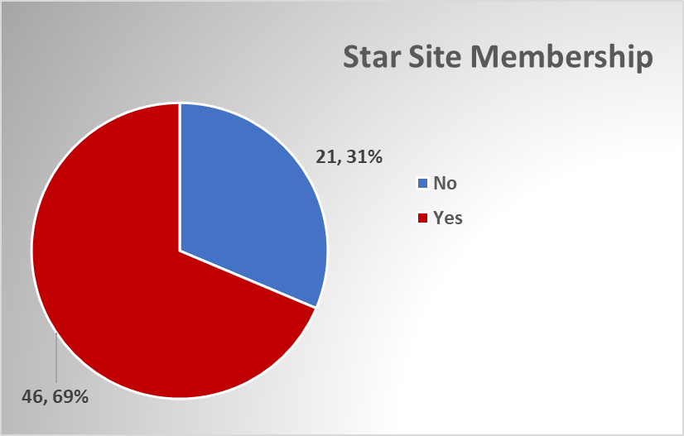
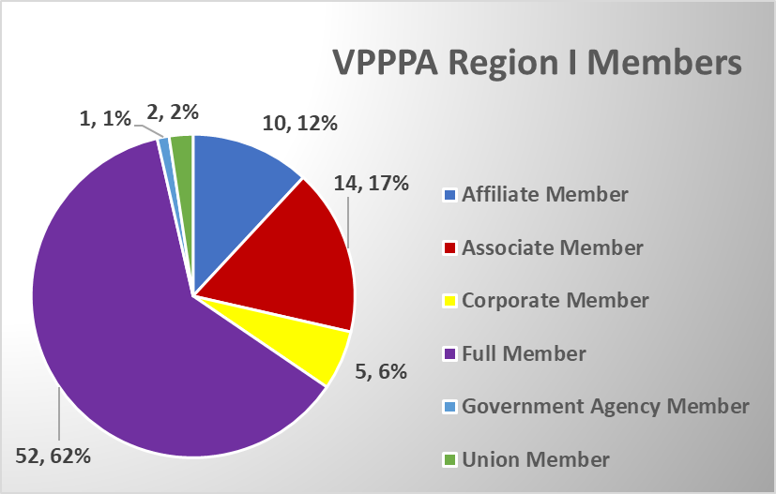

Slide 12

Mentoring Committee
Committee Chair:
  Darwin Irish, FLEXcon Company, Inc.

Slide 13
Mentoring may include (either within your own company or with another company):
Assisting with mentoring workshops
Conducting field visits at potential VPP sites (speaking with mgmt./labor)
Conducting mock on-site reviews with potential VPP sites
Assisting potential VPP sites with their application
Assisting potential VPP sites analyze problem areas
Sharing your knowledge of resources with potential VPP sites
Sharing techniques and preparation strategies with potential VPP sites
Advising/sharing with Various Collective Bargaining Groups

Slide 14

“Reaching Out”
Phone calls
E-mails
Meetings:
At your site
At their site
At Conferences
At Chapter Meetings

Slide 15
Mentor Mentee
CoCa Cola Harris Rebar (Deerfield, Ma.)
Cartamundi Mayberry Mat. Handling (East Longmeadow, Ma.)
Cintas (Branford, Ct., Winsor, Ct)
Raytheon Co. New England Sheets (Devens, Ma.)
Pratt and Whitney Sysco Corp. (Westbrook, Me)
FLEXcon High Liner Foods (Peabody, Ma)
Dominion Energy Honeywell, (Northford, CT)
Acushnet Chatham Village Foods (Wareham, MA)

Slide 16
Region One Mentoring Contacts
Darwin Irish, FLEXcon Company, Inc.
e-mail: DIrish@Flexcon.com
Brian Sullivan, Region I VPP Coordinator
US Dept. of Labor – OSHA
e-mail: Sullivan.Brian@dol.gov

Slide 17
Awards Committee
Committee Chair:
  Paul Ludington, Millstone Nuclear Power Station
  3 Scholarships Available: All are worth $1,000.00
  Eric Bartsch Memorial Safety & Health Scholarship
  Sarah Iodice Raytheon
  Caswell Plante Academic Excellence Scholarship
Colin Lomasney Raytheon
  Joseph Gervais Memorial Community Service Scholarship
  Mikaila French Dominion Nuclear CT

Slide 18
By-Laws Committee
Committee Chair:
  Deb Bowie, Coca-Cola Northampton
By-Law: No changes at this time

Slide 19


Slide 20
Vermont State Plan
Committee Chair:
  Daniel Whipple, VOSHA Program Manager
    E-mail: dan.whipple@vermont.gov
    Phone: (802)-828-5084
  Karl Hayden VPP program coordinator
    E-mail: karl.hayden@vermont.gov
    Phone: (802)-828-2033
  Continuing to support the
  Green Mountain VPP
Strong Safety and Health Programs = Sound Business

Slide 21
Active GMVPP Sites:
Energizer Battery-Bennington
Ben and Jerry’s-Saint Albans
Curtis Lumber-Burlington
GE-Rutland
Globalfoundries-Essex Junction
Vermont Electric Coop (VEC)
ATC Group Services, LLC

Slide 22
Region I Conference Locations
2005 – CT @ Mystic Marriott
2006 – VT @ Burlington Sheraton
2007 – CT @ Mystic Marriott
2008 – RI @ Newport Marriott
2009 – VT @ Killington
2010 – ME @ Sugarloaf
2011 – MA @ Ocean Edge, Cape Cod
2012 - VT @ Killington
2013 - MA @ Ocean Edge, Cape Cod
2014 – ME @ Inn by the Bay, Portland
2015 – MA @ Sea Crest, N. Falmouth
2016 – NH @ Radisson, Manchester
2017 – VT @ Killington
2018 – MA @ Sea Crest, N. Falmouth
2019 – ME @ Inn by the Bay, Portland
2020 – VT @ Killington
2021 - TBD

Slide 23
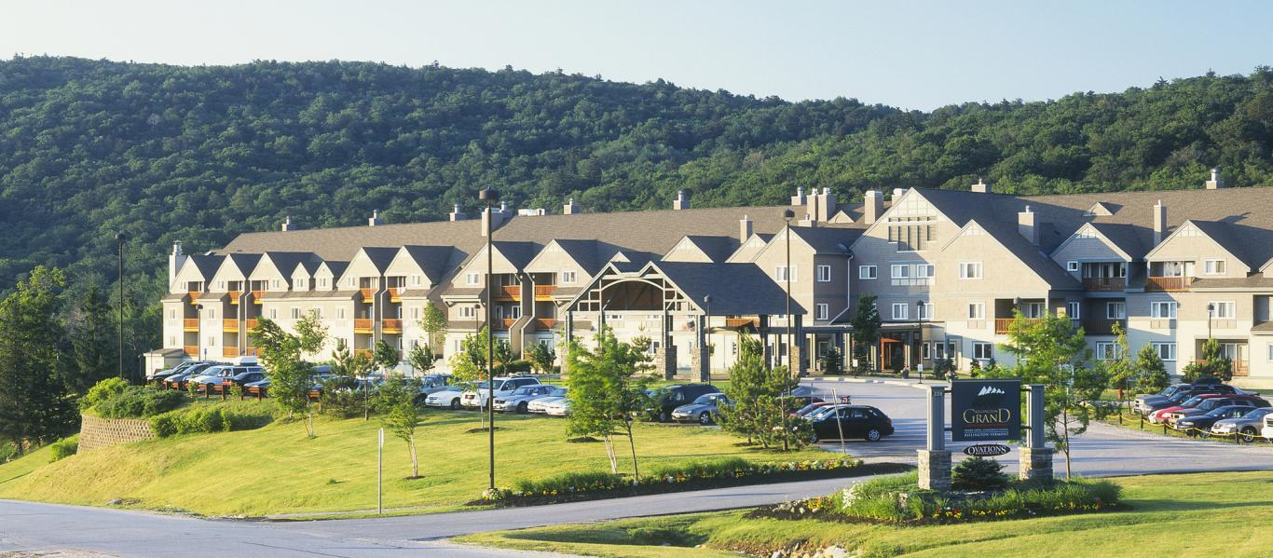

The 2020 VPPPA Region I
Conference & Exposition
will be held at the
Killington Resort, VT
June 15 - 17

Slide 24
Old Business
Any Old Business?
New Business –
  Future Annual Safety + National Symposium Ernest N. Morial Convention Center, New Orleans, LA Aug 27th - Aug 30th
  Looking for Host Site for Fall Chapter Meeting

Slide 25

Region I, VPPPA
“The Best in the Northeast!”
THANKS TO YOU!!!

