Slide 1

VPPPA Region 1
OSHA Region 1
VPP

Slide 2

2018 - 2019 On-site VPP evaluations
16 on-site evaluations scheduled
  14 re-approvals
  3-4 initial evaluations - NEW
    A J Oster - Warwick, RI
    Huber Engineered Woods LLC – Easton, ME
    Harris Rebar – Deerfield, MA
    Charter Contracting Co. (MWF) – Boston, MA
      Applicant

Slide 3
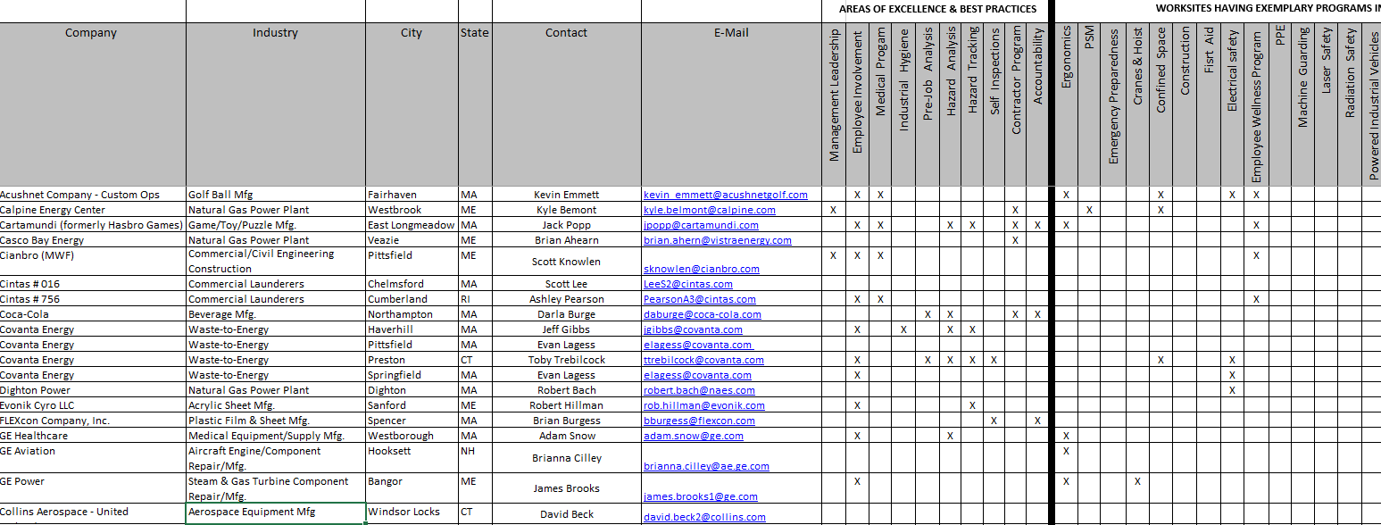
Best Practices

Slide 4
OSHA Updates
Trenching Hazards
Safety Device Recalls (i.e. – ladders, personnel lifts, fall protection devices)
Fall Stand Down – May 6-10
Opioid Awareness
Request for information – Powered Industrial Vehicles
Safe & Sound Week – August 12-18
OSHA VPP Continuous Process Improvement
  VPP Application (pilot)

Slide 5
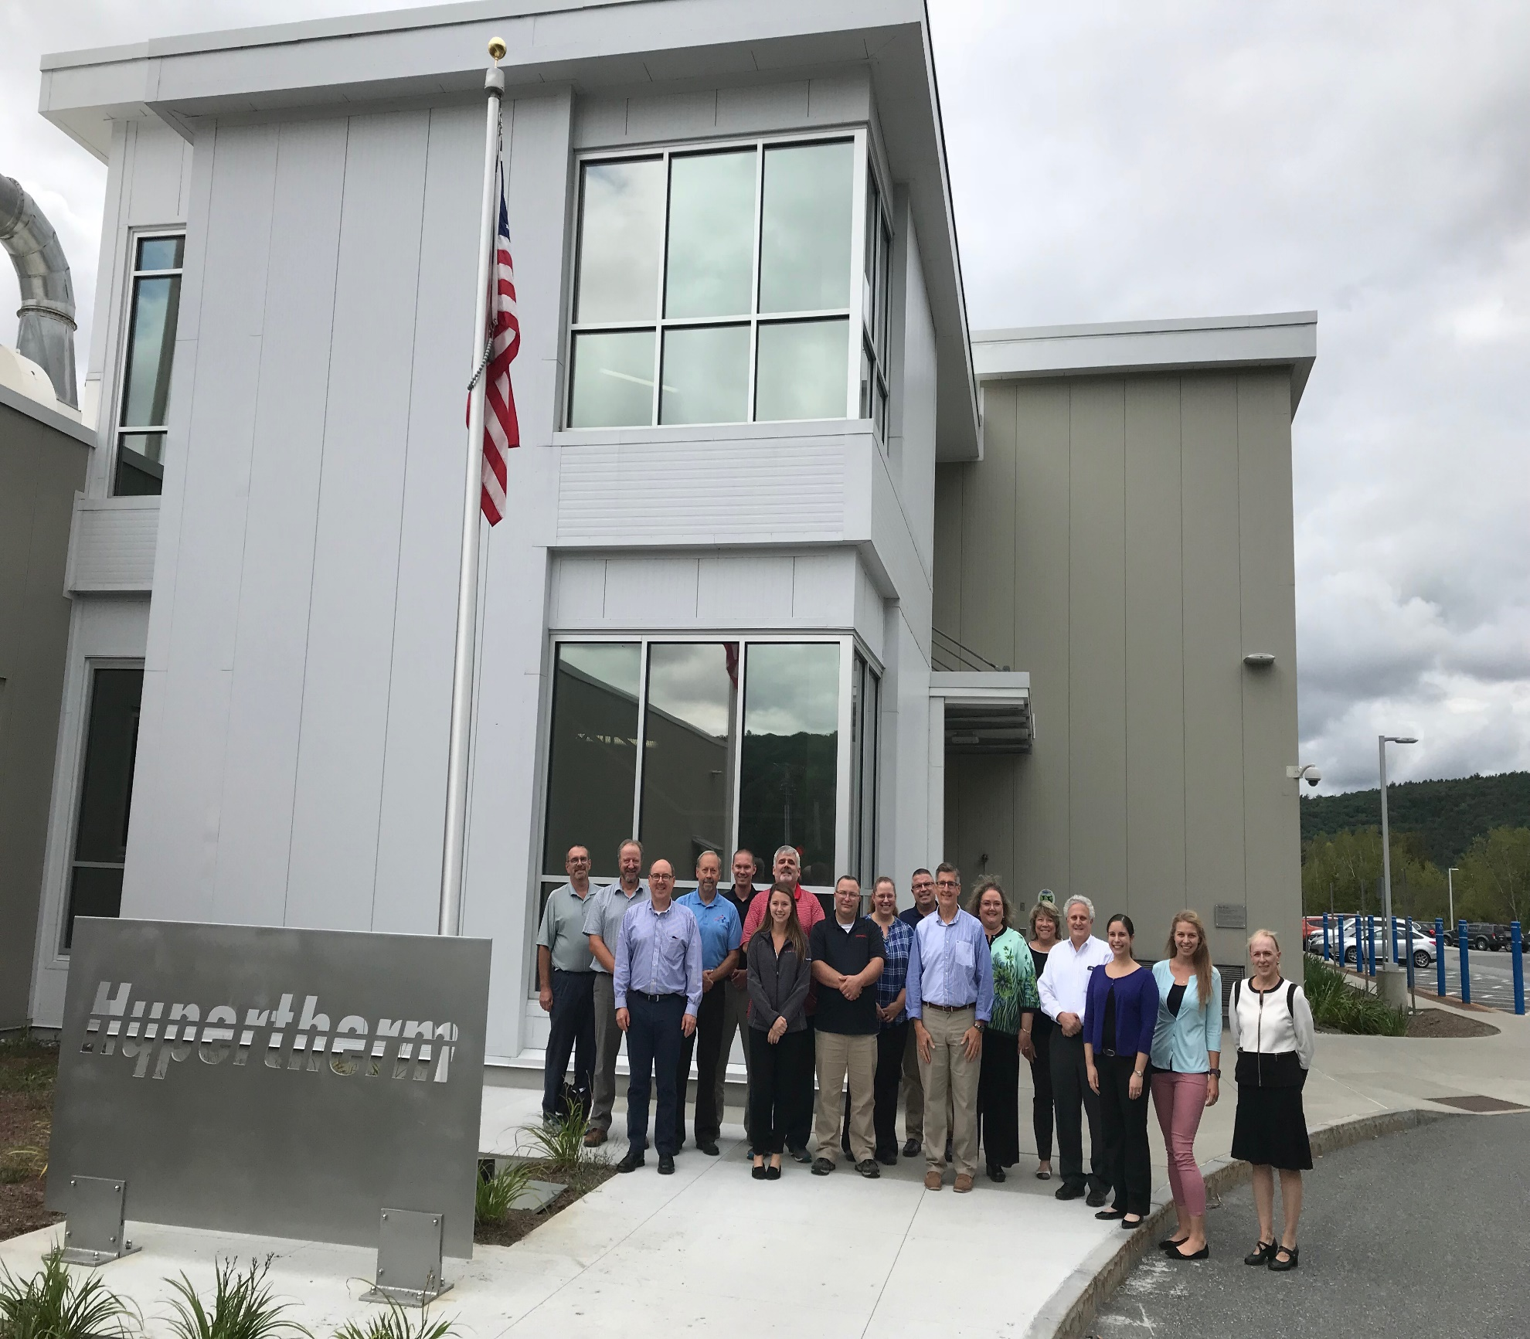

OSHA SGE Program

Slide 6
SGE Training Class - 2018
September 18-20, 2018
Host – Hypertherm – Lebanon, NH – 10 new SGE’s
Multidisciplinary class instructors
  Thank you to SGE’s – Darwin Irish, David Kiser, Laurie Morehouse , Richard Racine
  Management Commitment & Employee Involvement
  Worksite Analysis
  Hazard Prevention & Control
  Health & Safety Training

Slide 7

Next SGE Training Class - 2020

Slide 8

SGE Renewals
- Submit renewal application
6 months prior to expiration date.
- Application Deadlines:
Jan 15, April 15, July 15, Oct 15
SGE Coordinator
U.S. Department of Labor – OSHA
200 Constitution Ave., NW Rm. N-3700
Washington, DC 20210
Office: (202) 693-2213
Fax: (202) 693-1671
SGECoordinator@dol.gov

Slide 9
SGE’s – Review of Annual Self-Evaluations
Will ask for about 20 SGEs to assist in review of annual self-evaluations
  3 self-evaluations to review
  Sites will be contacted for potential conflicts
  SGE approvals by OSHA National Office (vetting)
  Electronic copies will be sent
  Form to be completed during review

